Slide 1
Cyber Security

Slide 2

Security basics

Slide 3
ILO’s
Be able to explain cyber security and the cyber security threats covered by the specification.
Be able to explain penetration testing and what it is used for

Slide 4
Cyber security definitions
The processes, practices and technologies designed to protect networks, computers, programs and data from attack, damage or unauthorised access
Main purpose: protection of computer networks/devices from sensitive, personal data

Slide 5
The main threats
Social engineering techniques
Malicious code
Pharming
Weak and default passwords
Misconfigured access rights
Removable media
Unpatched and/or outdated software.

Slide 6
The main threats
Social engineering techniques
Malicious code
Pharming
Weak and default passwords
Misconfigured access rights
Removable media
Unpatched and/or outdated software.

Slide 7
The main threats
Social engineering techniques
Malicious code
Pharming
Weak and default passwords
Misconfigured access rights
Removable media
Unpatched and/or outdated software.

Slide 8

Weak and default passwords
“A lock is only as good as the key”
Easy to guess passwords are a hackers dream
in 2017, the two most common passwords were “123456” and “password”
Default passwords need to be changed in case the original algorithm is solved

Slide 9
Weak and default passwords
“A lock is only as good as the key”
Easy to guess passwords are a hackers dream
in 2017, the two most common passwords were “123456” and “password”
Default passwords need to be changed in case the original algorithm is solved
What should passwords contain to make them harder to crack?

Slide 10
Weak and default passwords
“A lock is only as good as the key”
Easy to guess passwords are a hackers dream
in 2017, the two most common passwords were “123456” and “password”
Default passwords need to be changed in case the original algorithm is solved
What should passwords contain to make them harder to crack?
Combination of lower/upper case characters, numbers and symbols

Slide 11
Weak and default passwords
“A lock is only as good as the key”
Easy to guess passwords are a hackers dream
in 2017, the two most common passwords were “123456” and “password”
Default passwords need to be changed in case the original algorithm is solved
What should passwords contain to make them harder to crack?
Combination of lower/upper case characters, numbers and symbols
A password with 5 characters takes around 3.7 seconds to crack, whereas a 24 character takes 7.5 million years!

Slide 12
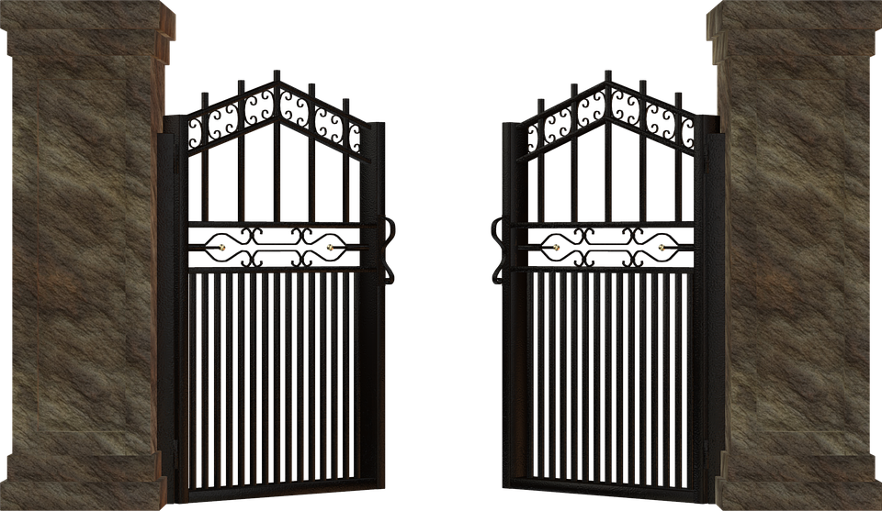
Misconfigured access rights
When a user has access when they shouldn’t have
Recent news example
Opportunist cyber criminals can take advantage

Slide 13

Removable media
Spy movie cliché and real threat
USB sticks can contain malware – malicious code
Some companies enforce the strict use of encrypted devices only

Slide 14
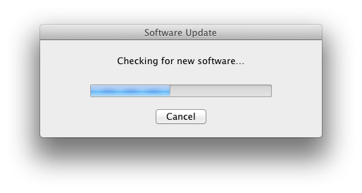
Unpatched and/or outdated software
Bugs are doorway for hackers to pass through and gain sensitive information
Complex software often have bugs that need to be regularly patched and updated
Software is only secure when developers are actively dealing with security flaws
Old software, that is not updated, will not undergo patches

Slide 15
Unpatched and/or outdated software.
Bugs are doorway for hackers to pass through and gain sensitive information
Complex software often have bugs that need to be regularly patched and updated
Software is only secure when developers are actively dealing with security flaws
Old software, that is not updated, will not undergo patches
What was the last update you did?

Slide 16

Testing security – Penetration testing
The process of attempting to gain access to resources without knowledge of usernames, passwords and other normal means of access
It is a very useful way of testing systems to identify where weaknesses are in the system, such as any software bugs or default passwords
Two types:
White-box – simulate the knowledge of an insider
Black-box – simulate external hacker, trial and error approach

Slide 17
Exercises
Make flash cards summarising what we have learnt today
Test yourself until you get all of them correct

Slide 18
ILO’s
Be able to explain cyber security and the cyber security threats covered by the specification.
Be able to explain penetration testing and what it is used for

Slide 19

Social engineering

Slide 20
ILO’s
Be able to describe social engineering and methods that are suitable for protecting from social engineering threats.

Slide 21
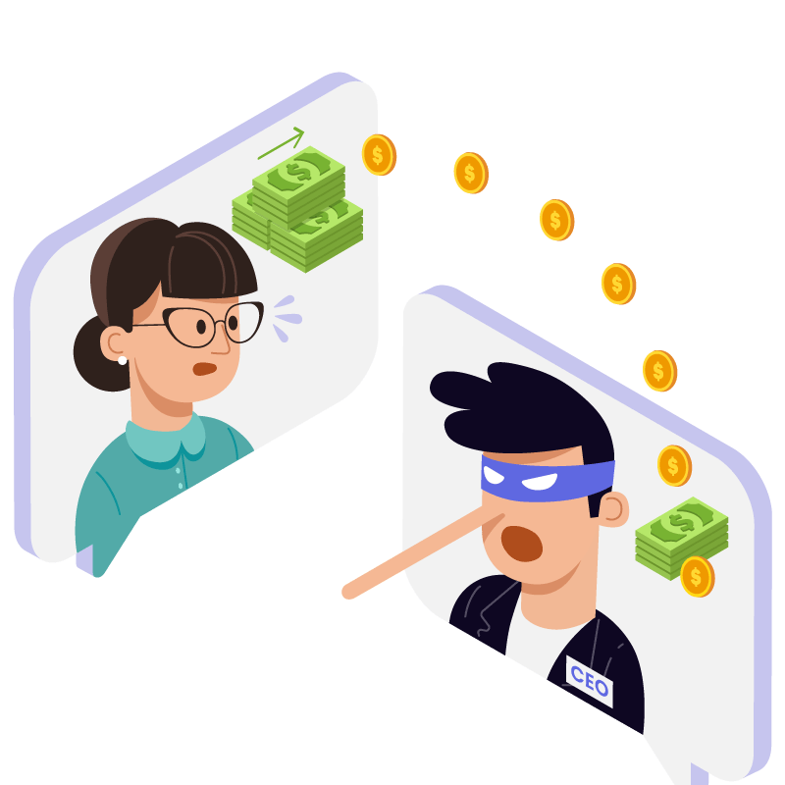
Social engineering
Social engineering is the art of manipulating people so they give up confidential information
Comes in many forms:
Blagging
Pharming
Shouldering
Phishing

Slide 22

Blagging
The act of creating and using an invented scenario, to engage a targeted victim in a manner that increases the chance the victim will divulge information, or perform actions, that would be unlikely in ordinary circumstances
“I’m from Lloyds Bank…Can I have your bank account details?”
Prevention:
Don’t give out personal details!

Slide 23
Blagging
The act of creating and using an invented scenario, to engage a targeted victim in a manner that increases the chance the victim will divulge information, or perform actions, that would be unlikely in ordinary circumstances
“I’m from Lloyds Bank…Can I have your bank account details?”
Prevention:
Don’t give out personal details!
Do you know any examples of blagging?
https://www.youtube.com/watch?v=R9biM_ZfIdo&pp=ygUKZm9uZWphY2tlcg%3D%3D

Slide 24

Pharming
Cyber attack intended to redirect a website’s traffic to another, fake site
This is done by either changing the host files on the victim’s computer, or by affecting the DNS system which redirects traffic
Harder to avoid
Prevention:
Double check URL’s
Use a trusted internet service provider
Check padlock icon

Slide 25
Pharming
Cyber attack intended to redirect a website’s traffic to another, fake site
This is done by either changing the host files on the victim’s computer, or by affecting the DNS system which redirects traffic
Harder to avoid
Prevention:
Double check URL’s
Use a trusted internet service provider
Check padlock icon
Do you know of any pharming examples?

Slide 26

Shouldering
Observing someone's information from “over their shoulder”
As simple as peeking at someone's PIN at a cashpoint
Either in person or using a camera
Prevention:
Take care when using public devices
Try and shield details

Slide 27
Shouldering
Observing someone's information from “over their shoulder”
As simple as peeking at someone's PIN at a cashpoint
Either in person or using a camera
Prevention:
Take care when using public devices
Try and shield details
How are passwords concealed from shielding when using websites?

Slide 28
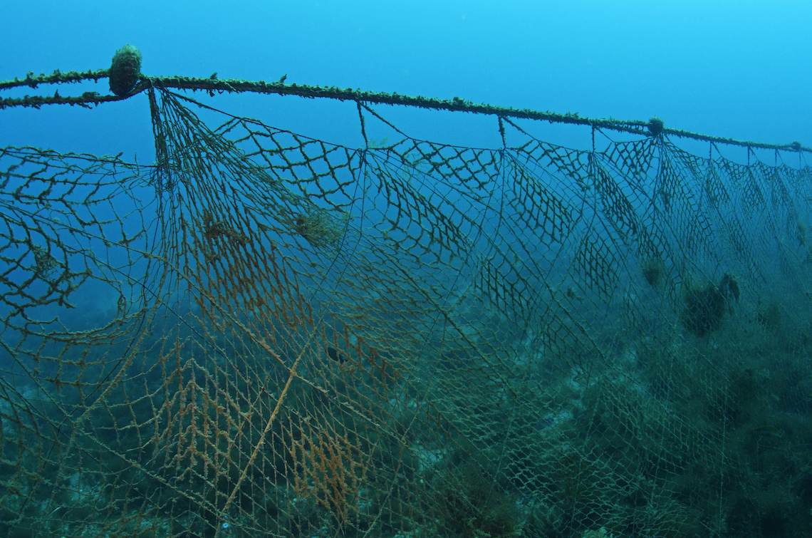
Phishing
Technique of fraudulently obtaining private information, often using email or SMS
The key difference between phishing and blagging, is that blagging is targeted towards one individual, whilst phishing is broader and hopes to get someone to bite
Prevention:
Common sense
Check for spelling mistakes
Never click on any shared links

Slide 29
Phishing
Technique of fraudulently obtaining private information, often using email or SMS
The key difference between phishing and blagging, is that blagging is targeted towards one individual, whilst phishing is broader and hopes to get someone to bite
Prevention:
Common sense
Check for spelling mistakes
Never click on any shared links
What examples of phishing do you know?

Slide 30
Exercises
Make flash cards summarising what we have learnt today
Test yourself until you get all of them correct

Slide 31
ILO’s
Be able to explain cyber security and the cyber security threats covered by the specification.
Be able to explain penetration testing and what it is used for

Slide 32
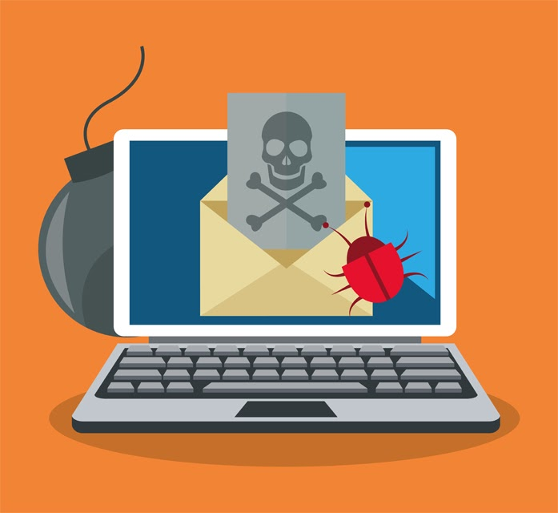
Malware

Slide 33
ILO’s
Be able to describe malware and methods that are suitable for protecting from malware threats

Slide 34
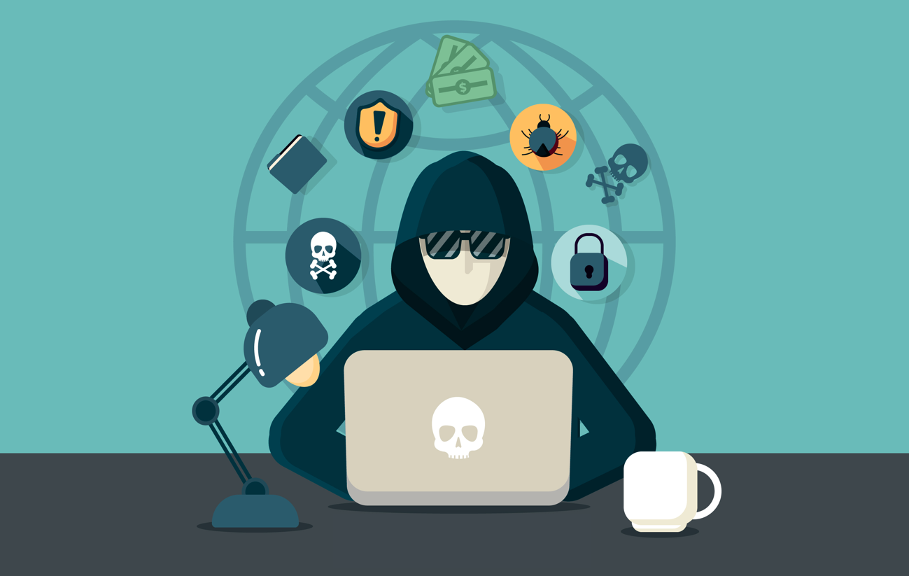
Malware
Short-name for malicious software is an umbrella term used to refer to a variety of forms of hostile or intrusive software
Can be protected from using antivirus software
Comes in many forms:
Virus
Trojan
Spyware
Adware

Slide 35

Virus
A virus is a piece of self-replicating piece of code that attaches itself to a file and when executed, is able to replicate itself without the user’s consent
They usually perform a harmful activity on the computer such as using hard disk space, corrupting data or even turning the computer into a zombie

Slide 36
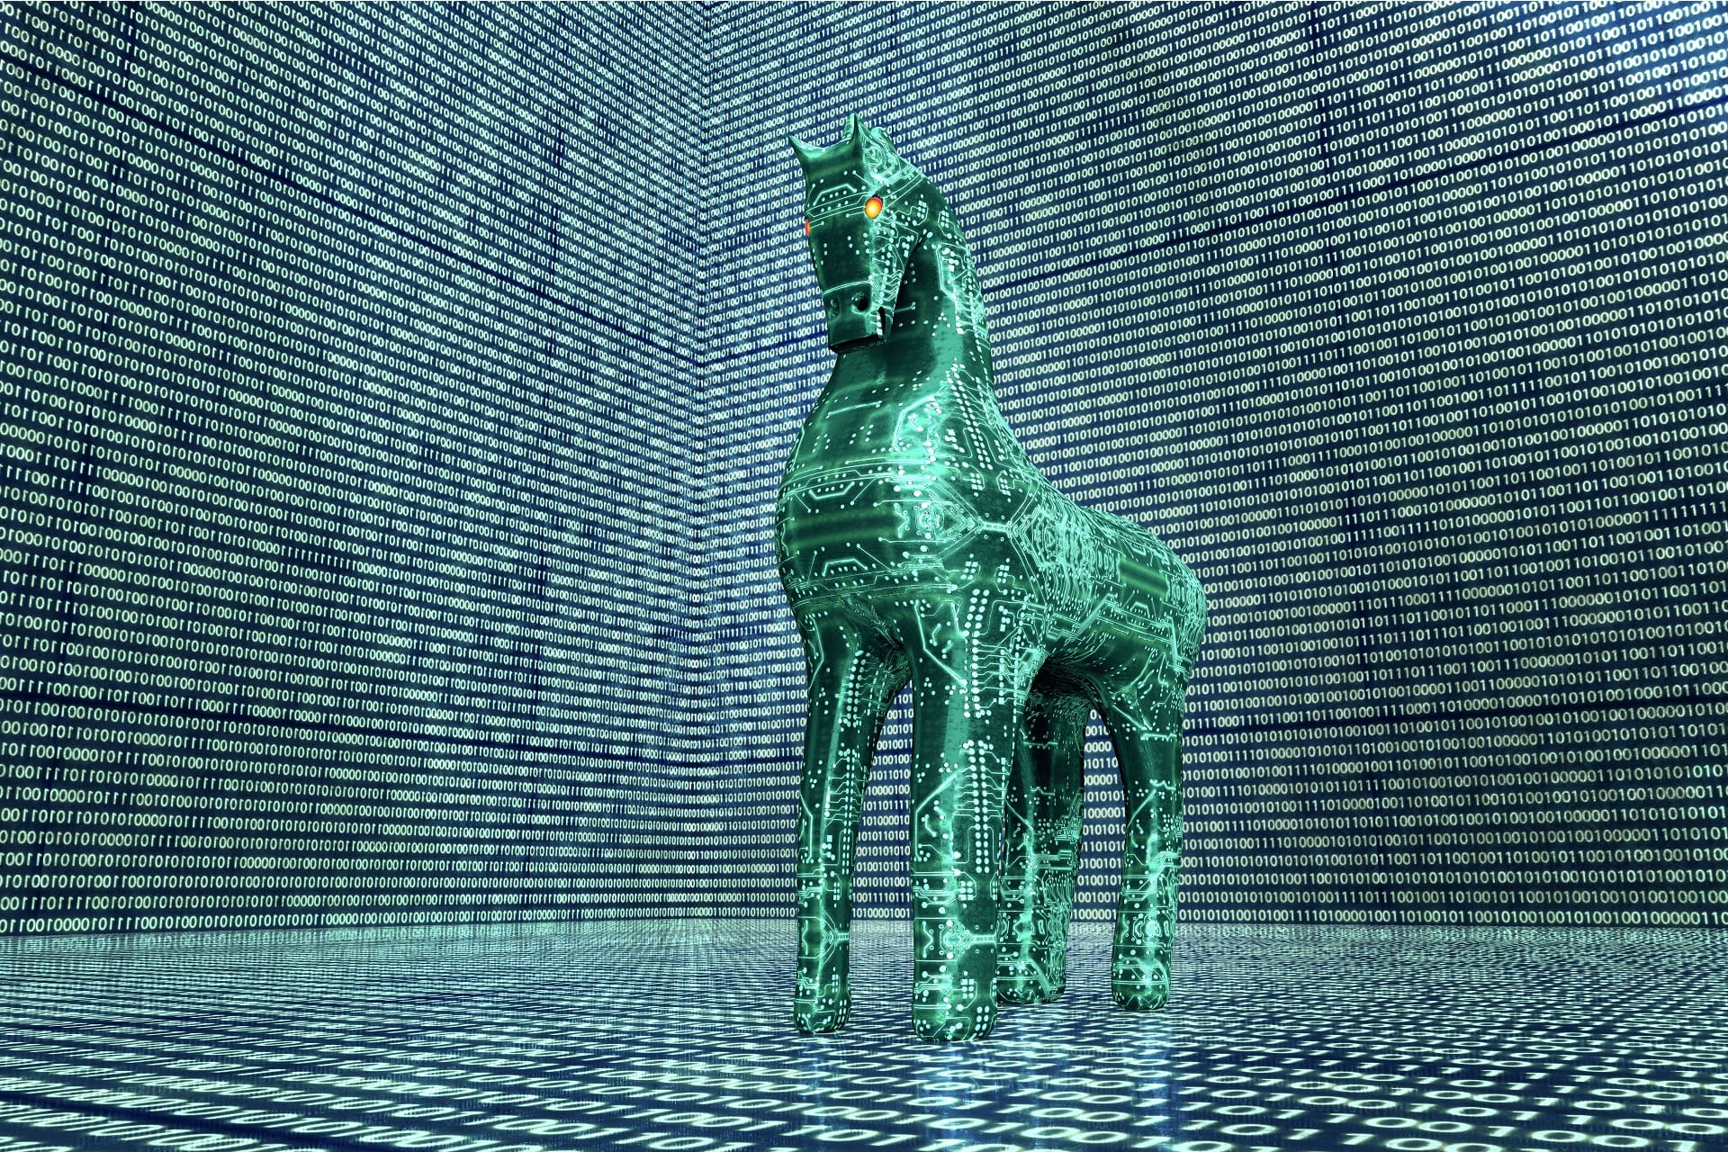
Trojan
Malware disguised as a piece of legitimate software, trojans sit on the computer and allow the cyber-thieves to have access to your system
Typical things that a trojan might do include creating a backdoor into the system, modifying or deleting data or just disrupting the performance of the computer
Unlike viruses, they cannot self-replicate, but are often used in phishing scams

Slide 37

Spyware
Programs that secretly record what you do on the computer
They could be used for legitimate purposes, but are often used to steal personal data
One form of spyware is a key logger which monitors all keyboard presses, and uses these to steal passwords

Slide 38

Adware
Two definitions for adware
Software that contains advertisements, such as freeware games
These are often legitimate programs which make use of advertising revenue to provide free/cheap games to customers
Form of spyware that is used to provide targeted adverts
For example, when using a web browser, you may decide to start looking up flights to the USA on Google, and suddenly all the adverts provided on social media are about things to do in the USA, and cheap flight companies

Slide 39
Exercises
Make flash cards summarising what we have learnt today
Test yourself until you get all of them correct

Slide 40
ILO’s
Be able to describe malware and methods that are suitable for protecting from malware threats

Slide 41

Security measures

Slide 42
ILO’s
Be able to describe a range of security methods

Slide 43
Security measures
Many means we can protect and authenticate ourselves:
Biometric measures
Password systems
CAPTHCA
Email confirmations
Automatic software updates

Slide 44

Biometric measures
Uses biometrics to confirm a user’s identity
Biometrics relates to the measurements of the body, and could include finger prints, facial recognition, voice recognition or even retinal scanning

Slide 45
Biometric measures
Uses biometrics to confirm a user’s identity
Biometrics relates to the measurements of the body, and could include finger prints, facial recognition, voice recognition or even retinal scanning
Do any of your devices have these?

Slide 46
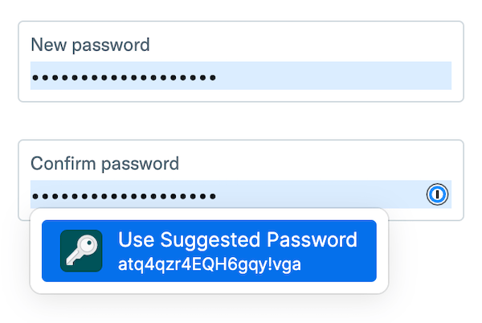
Password systems
Making use of passwords which are known only by those people who should access the system

Slide 47
Password systems
Making use of passwords which are known only by those people who should access the system
Do any of your devices have these?

Slide 48
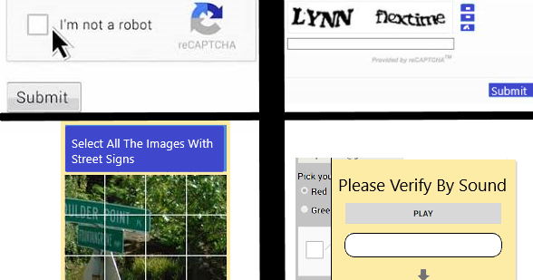
CAPTCHA

Slide 49
CAPTCHA
These are the little boxes that appear on the screen to prove you are not a robot
They include tests such as ‘select all the images of cars’ or ‘what do these words say’
The idea is to provide tasks that are very difficult for computers to perform, but relatively easy for humans
By doing this, it will stop bots from being able to repeatedly access a site to try and crack passwords

Slide 50
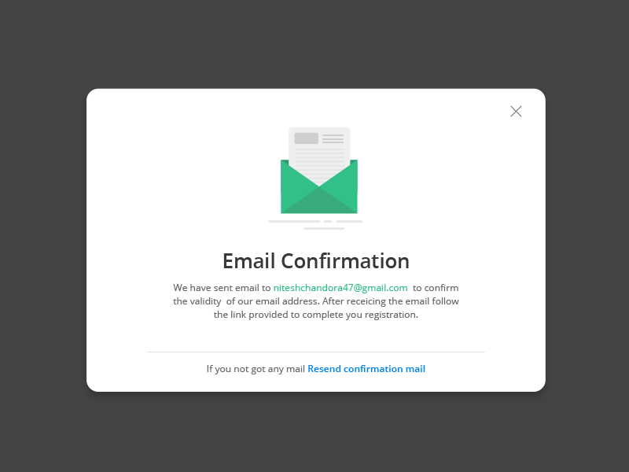
Email confirmations
Most companies will send through emails to your email account where you are able to complete additional tasks
For example, in order to reset your password, you may answer a few questions online, but the password reset link (or new temporary password) will ultimately be sent to your inbox so that you can confirm the details there

Slide 51
Automatic software updates
By automatically updating software, the bugs that are patched in new updates of programs will be automatically (and therefore quickly) fixed before they can be exploited

Slide 52
Exercises
Make flash cards summarising what we have learnt today
Test yourself until you get all of them correct

Slide 53
ILO’s
Be able to describe a range of security methods

Slide 54
Bonus video
Catch me if you can – guy (1hr)
https://www.youtube.com/watch?v=vsMydMDi3rI&pp=ygUaZ29vZ2xlIGNhdGNoIG1lIGlmIHlvdSBjYW4%3D

